Slide 1
Question Answering Type of questions, passage retrieval, answer extraction
Information Retrieval

Slide 2
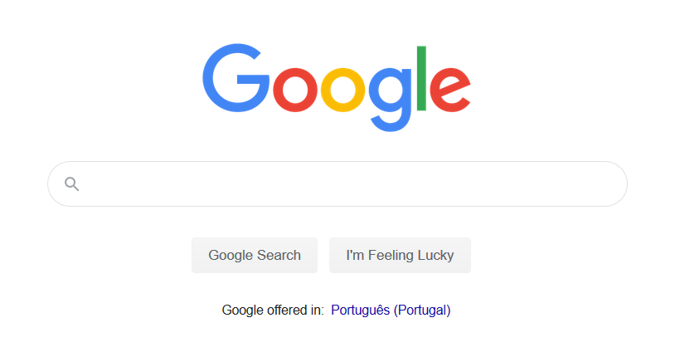


Beyond simple search?

Slide 3
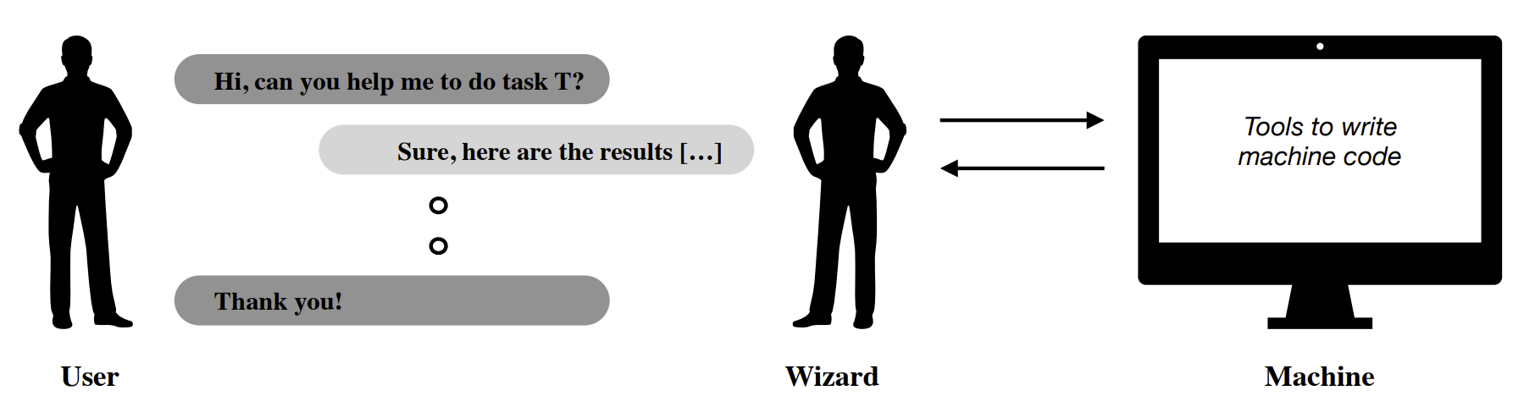
Language based systems
de Vries, H., Bahdanau, D., & Manning, C. (2020). Towards ecologically valid research on language user interfaces. arXiv preprint arXiv:2007.14435.
https://arxiv.org/abs/2007.14435

Slide 4
Paradigms
Question answering
Information seeking tasks
Task oriented conversation
Online shopping, booking, etc.
Open ended conversation
Information seeking tasks
Single turn Human-Agent interaction
Multi-turn Human-Agent interaction

Slide 5
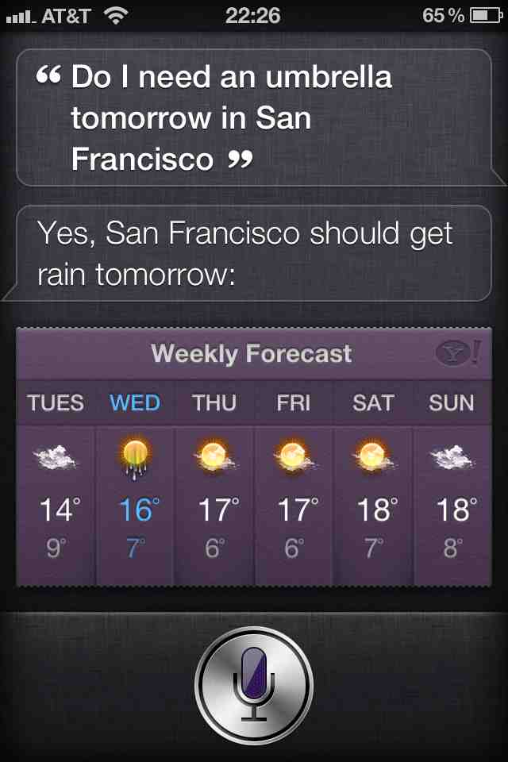
Mobile QA
Move to mobile favors a move to speech which favors natural language information search
Will we move to a time when over half of searches are spoken?

Slide 6
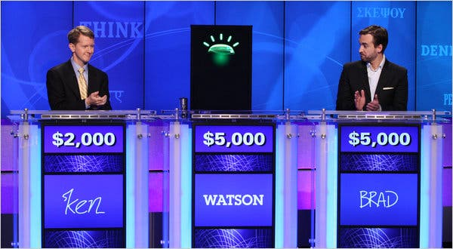
Question Answering: IBM’s Watson
Won Jeopardy on February 16, 2011!
WILLIAM WILKINSON’S “AN ACCOUNT OF THE PRINCIPALITIES OF WALLACHIA AND MOLDOVIA”
INSPIRED THIS AUTHOR’S MOST FAMOUS NOVEL
Bram Stoker

Slide 7
Types of Questions in Modern Systems
Factoid questions (this lecture)
Who wrote “The Universal Declaration of Human Rights”?
How many calories are there in two slices of apple pie?
What is the average age of the onset of autism?
Where is Apple Computer based?
Complex (narrative) questions (your project)
In children with an acute febrile illness, what is the efficacy of acetaminophen in reducing fever?
What do scholars think about Jefferson’s position on dealing with pirates?

Slide 8
Commercial systems: mainly factoid QA
Where is the Louvre Museum located? | In Paris, France
What’s the abbreviation for limited partnership? | L.P.
What are the names of Odin’s ravens? | Huginn and Muninn
What currency is used in China? | The yuan
What kind of nuts are used in marzipan? | almonds
What instrument does Max Roach play? | drums
What is the telephone number for Stanford University? | 650-723-2300

Slide 9
Paradigms for QA
IR-based approaches
TREC; IBM Watson; Google
Structured knowledge-based approaches
IBM Watson; True Knowledge Evi, Apple Siri, Wolfram Alpha, Facebook Graph Search
Hybrid approaches
IBM Watson

Slide 10
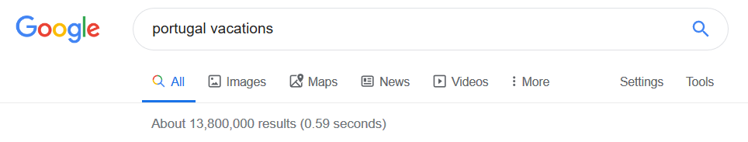
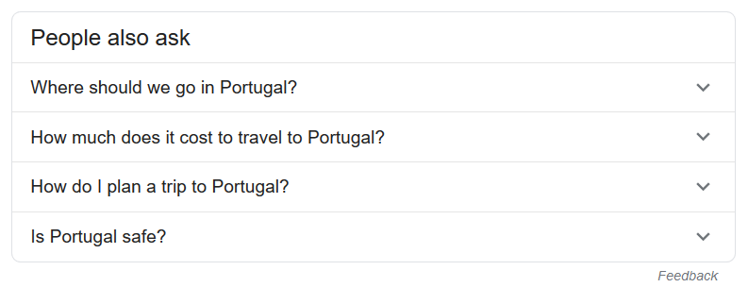
IR-based Question Answering

Slide 11
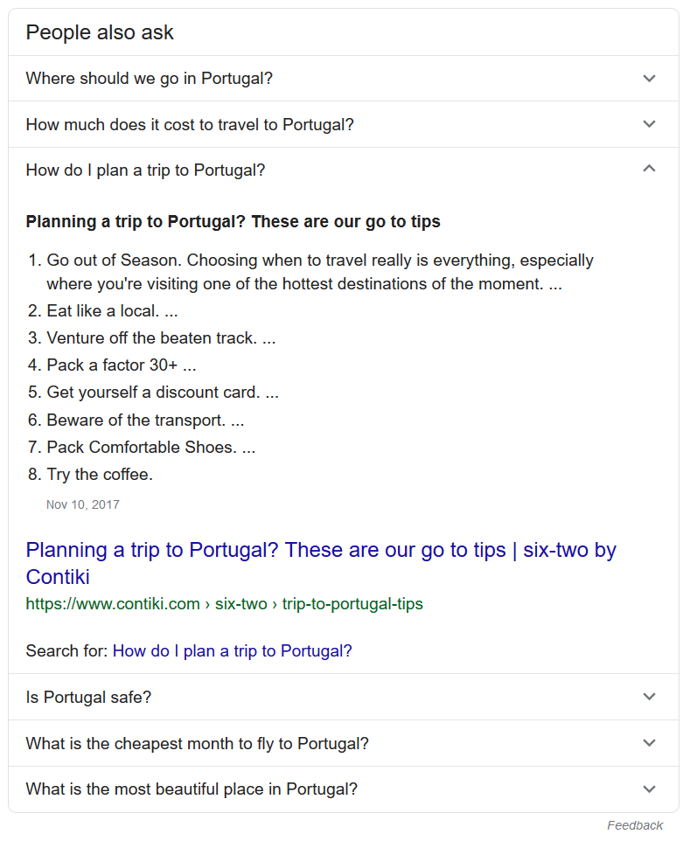
Question
Answer
(passage retrieval)
Expansion questions

Slide 12
IR-based Factoid QA
QUESTION PROCESSING
Detect question type, answer type, focus, relations
Formulate queries to send to a search engine
PASSAGE RETRIEVAL
Retrieve ranked documents
Break into suitable passages and rerank
ANSWER PROCESSING
Extract candidate answers
Rank candidates
using evidence from the text and external sources

Slide 13
Factoid Q/A

Slide 14



Open-domain Question Answering
SQuAD
Q: How many of Warsaw's inhabitants spoke Polish in 1933? ^{A: 833,500}
TREC
Q: What U.S. state’s motto is “Live free or Die”? ^{A: New Hampshire}
WebQuestions (Berant et al, 2013)
Q: What part of the atom did
Chadwick discover? ^{A: neutron}
WikiMovies (Miller et al, 2016)
Q: Who wrote the film Gigli? ^{A: Martin Brest}

Slide 15
Knowledge-based approaches
Build a semantic representation of the query
Times, dates, locations, entities, numeric quantities
Map from this semantics to query structured data or resources
Geospatial databases
Ontologies (Wikipedia infoboxes, dbPedia, WordNet, Yago)
Restaurant review sources and reservation services
Scientific databases

Slide 16
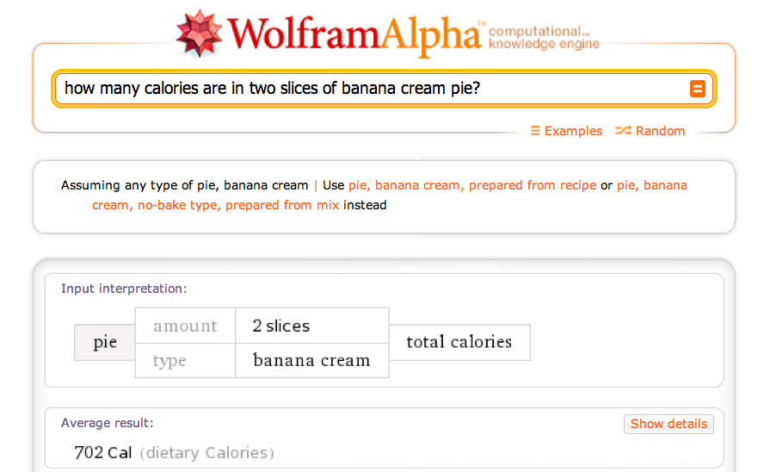
Wolfram Alpha

Slide 17


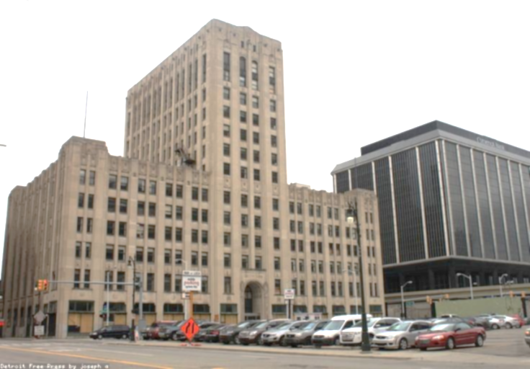
Knowledge bases
English Wikipedia
Web data
Washington Post news collection
TREC Complex Answer Retrieval v2.1 (may increase to 3.0 pending availability)
Article paragraph content from Wikipedia (Wikipedia dump from December 20, 2016)
Approximately 5 Million articles
This data is publicly available
MS MARCO Passage Reranking data
10 million answer candidates from Bing search
This data is publicly available
TREC Washington Post Corpus used by the TREC News Track
608,180 news articles and blog posts from 2012 through 2017
NOTE: This collection requires a data license agreement.

Slide 18
Hybrid approaches (IBM Watson)
Build a shallow semantic representation of the query
Generate answer candidates using IR methods
Augmented with ontologies and semi-structured data
Score each candidate using richer knowledge sources
Geospatial databases
Temporal reasoning
Taxonomical classification

Slide 19
Question Answering
Answer Types and Query Formulation

Slide 20
Factoid Q/A

Slide 21
Question Processing Things to extract from the question
Answer Type Detection
Decide the named entity type (person, place) of the answer
Query Formulation
Choose query keywords for the IR system
Question Type classification
Is this a definition question, a math question, a list question?
Focus Detection
Find the question words that are replaced by the answer
Relation Extraction
Find relations between entities in the question

Slide 22
Question Processing
They’re the two states you could be reentering if you’re crossing Florida’s northern border
Answer Type: US state
Query: two states, border, Florida, north
Focus: the two states
Relations: borders(Florida, ?x, north)

Slide 23
Answer Type Detection: Named Entities
Who founded Virgin Airlines?
PERSON
What Canadian city has the largest population?
CITY.

Slide 24
Answer Type Taxonomy
6 coarse classes
ABBEVIATION, ENTITY, DESCRIPTION, HUMAN, LOCATION, NUMERIC
50 finer classes
LOCATION: city, country, mountain…
HUMAN: group, individual, title, description
ENTITY: animal, body, color, currency…
Xin Li, Dan Roth. 2002. Learning Question Classifiers. COLING'02

Slide 25
Part of Li & Roth’s Answer Type Taxonomy

Slide 26
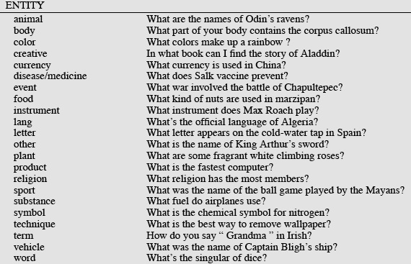
Answer Types

Slide 27
More Answer Types

Slide 28
Answer Types in Jeopardy
2500 answer types in 20,000 Jeopardy question sample
The most frequent 200 answer types cover < 50% of data
The 40 most frequent Jeopardy answer types
he, country, city, man, film, state, she, author, group, here, company, president, capital, star, novel, character, woman, river, island, king, song, part, series, sport, singer, actor, play, team, show, actress, animal, presidential, composer, musical, nation, book, title, leader, game
Ferrucci et al. 2010. Building Watson: An Overview of the DeepQA Project. AI Magazine. Fall 2010. 59-79.

Slide 29
Answer Type Detection
Hand-written rules
Machine Learning
Hybrids

Slide 30
Answer Type Detection
Regular expression-based rules can get some cases:
Who {is|was|are|were} PERSON
PERSON (YEAR – YEAR)
Other rules use the question headword:
(the headword of the first noun phrase after the wh-word)
Which city in China has the largest number of foreign financial companies?
What is the state flower of California?

Slide 31
Answer Type Detection
Most often, we treat the problem as machine learning classification
Define a taxonomy of question types
Annotate training data for each question type
Train classifiers for each question class using a rich set of features.
features include those hand-written rules!

Slide 32
Features for Answer Type Detection
Question words and phrases
Part-of-speech tags
Parse features (headwords)
Named Entities
Semantically related words

Slide 33
Keyword Selection Algorithm
1. Select all non-stop words in quotations
2. Select all NNP words in recognized named entities
3. Select all complex nominals with their adjectival modifiers
4. Select all other complex nominals
5. Select all nouns with their adjectival modifiers
6. Select all other nouns
7. Select all verbs
8. Select all adverbs
9. Select the QFW word (skipped in all previous steps)
10. Select all other words
Dan Moldovan, Sanda Harabagiu, Marius Paca, Rada Mihalcea, Richard Goodrum, Roxana Girju and Vasile Rus. 1999. Proceedings of TREC-8.

Slide 34
Choosing keywords from the query
Slide from Mihai Surdeanu
Who coined the term “cyberspace” in his novel “Neuromancer”?
1
1
4
4
7
cyberspace/1 Neuromancer/1 term/4 novel/4 coined/7

Slide 35
Question Answering
Passage Retrieval and Answer Extraction

Slide 36
Passage Retrieval
Step 1: IR engine retrieves documents using query terms
Step 2: Segment the documents into shorter units
something like paragraphs
Step 3: Passage ranking
Use answer type to help rerank passages

Slide 37
Features for Passage Ranking
Either in rule-based classifiers or with supervised machine learning
Number of Named Entities of the right type in passage
Number of query words in passage
Number of question N-grams also in passage
Proximity of query keywords to each other in passage
Longest sequence of question words
Rank of the document containing passage

Slide 38
Factoid Q/A

Slide 39
Answer Extraction
Run an answer-type named-entity tagger on the passages
Each answer type requires a named-entity tagger that detects it
If answer type is CITY, tagger has to tag CITY
Can be full NER, simple regular expressions, or hybrid
Return the string with the right type:
Who is the prime minister of India (PERSON)
Manmohan Singh, Prime Minister of India, had told left leaders that the deal would not be renegotiated.
How tall is Mt. Everest? (LENGTH)
The official height of Mount Everest is 29035 feet

Slide 40
Ranking Candidate Answers
But what if there are multiple candidate answers!
Q: Who was Queen Victoria’s second son?
Answer Type: Person
Passage:
The Marie biscuit is named after Marie Alexandrovna, the daughter of Czar Alexander II of Russia and wife of Alfred, the second son of Queen Victoria and Prince Albert

Slide 41
Ranking Candidate Answers
But what if there are multiple candidate answers!
Q: Who was Queen Victoria’s second son?
Answer Type: Person
Passage:
The Marie biscuit is named after Marie Alexandrovna, the daughter of Czar Alexander II of Russia and wife of Alfred, the second son of Queen Victoria and Prince Albert

Slide 42
Features for ranking candidate answers
Answer type match: Candidate contains a phrase with the correct answer type.
Pattern match: Regular expression pattern matches the candidate.
Question keywords: # of question keywords in the candidate.
Keyword distance: Distance in words between the candidate and query keywords
Novelty factor: A word in the candidate is not in the query.
Apposition features: The candidate is an appositive to question terms
Punctuation location: The candidate is immediately followed by a comma, period, quotation marks, semicolon, or exclamation mark.
Sequences of question terms: The length of the longest sequence of question terms that occurs in the candidate answer.

Slide 43
Candidate Answer scoring in IBM Watson
Each candidate answer gets scores from >50 components
(from unstructured text, semi-structured text, triple stores)
logical form (parse) match between question and candidate
passage source reliability
geospatial location
California is ”southwest of Montana”
temporal relationships
taxonomic classification

Slide 44
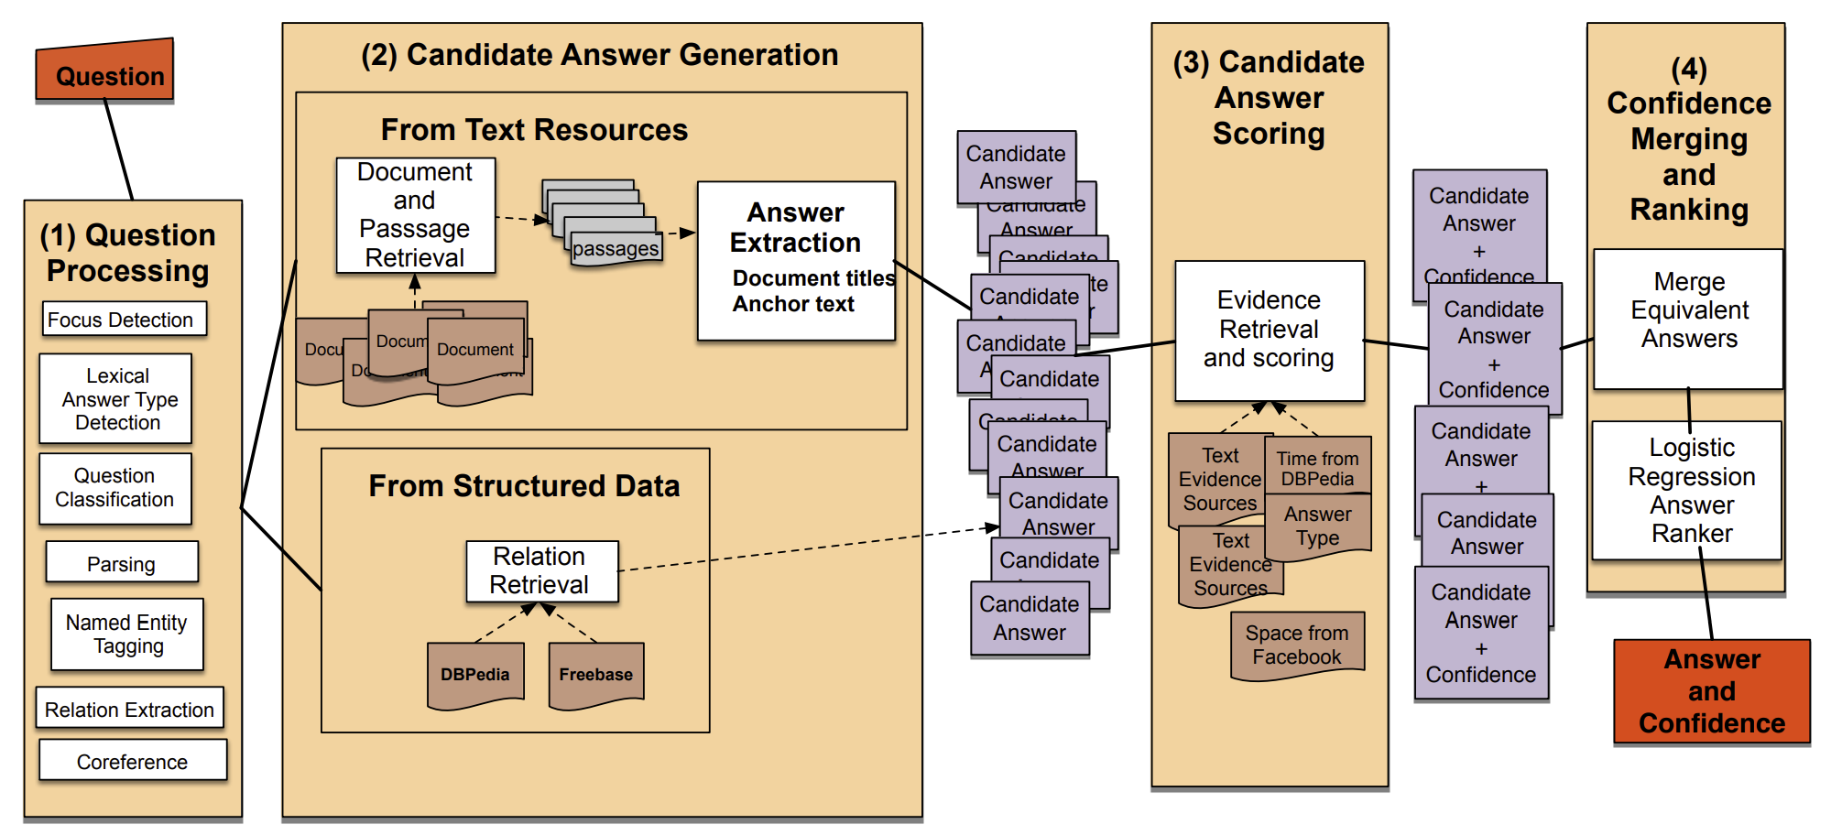
IBM Watson Jeopardy

Slide 45
Summary: Question-Answering
QUESTION PROCESSING
Detect question type, answer type, focus, relations
Formulate queries to send to a search engine
PASSAGE RETRIEVAL
Retrieve ranked documents
Break into suitable passages and rerank
ANSWER PROCESSING
Extract candidate answers
Rank candidates
using evidence from the text and external sources
Readings:
Dan Jurafsky and James H. Martin, Speech and Language Processing, Chapter 25, Question-Answering.
https://web.stanford.edu/~jurafsky/slp3/25.pdf

Slide 46
Types of Questions in Modern Systems
Factoid questions (this lecture)
Who wrote “The Universal Declaration of Human Rights”?
How many calories are there in two slices of apple pie?
What is the average age of the onset of autism?
Where is Apple Computer based?
Complex (narrative) questions (your project)
In children with an acute febrile illness, what is the efficacy of acetaminophen in reducing fever?
What do scholars think about Jefferson’s position on dealing with pirates?

Slide 47
Yes / No questions
The turn seeks a passage that answers a question and provides a brief justification or explanation to support the answer.
The highest-quality responses give the answer and an explanation that provides confidence that the answer is correct.

Slide 48
List questions
The question seeks a passage that provides a list.
When the system must make choices they should be popular, well-known, or with the most important elements preferred.
For example, for the turn, “shark species that are endangered”, the most endangered species of sharks, or species that most people would know, are preferred. Variations of a lesser-known species are OK, but less preferred.

Slide 49
“Describe, what is/are” questions
This question seeks a brief, general description or summary of the subject.
When there is a lot of information about the subject, the highest-quality responses focus on the most well-known aspects of the subject.
For example, high-quality responses for “Tell me more about Tesla” would describe the kinds of cars it manufactures, its battery business, its likelihood of surviving financially, and/or its celebrity CEO, but not less important facets like its location or overly detailed facets like its 2018 Q2 financial statement.

Slide 50
Comparison or Connection Questions (asking about the relation/difference between two concepts)
This question seeks passages containing comparisons or connection between the concepts discussed.
It should include details of the relationships between the two, which are also the main-focus of the topic.

Slide 51
Compositional Questions
Compositional questions (when and why) ask about two aspects of one concept.
For example, when and why something happened.
This type of question can be considered a combination of two questions.

Slide 52
The role of knowledge bases
Google Knowledge Graph
Facebook Graph Search
Bing’s Satori
Things like Wolfram Alpha
Common theme: Doing graph search over structured knowledge rather than traditional text search

Slide 53
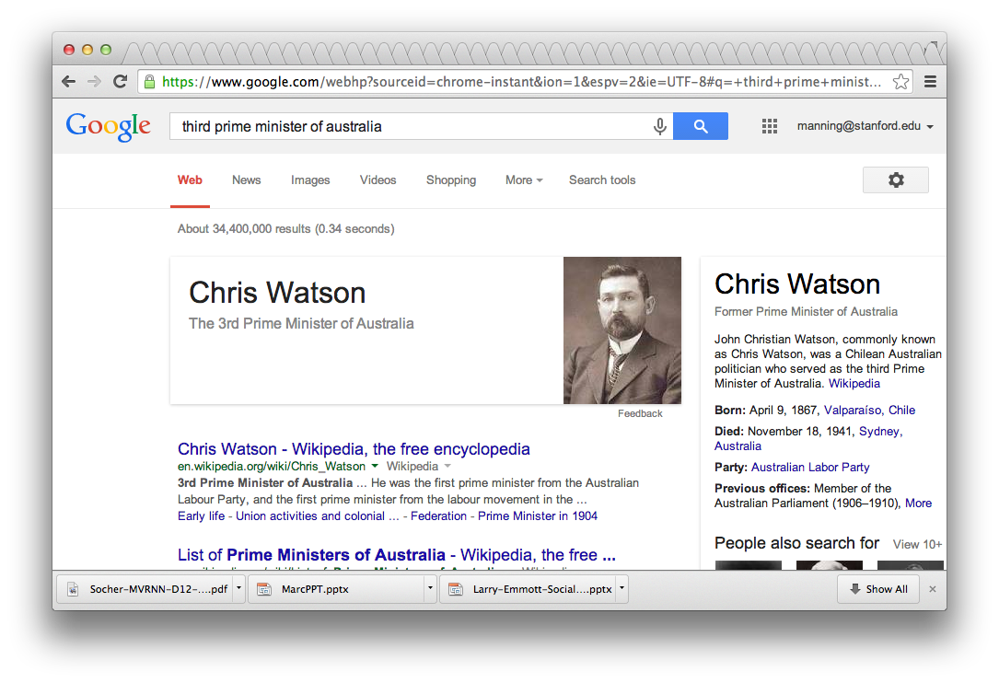
Understanding questions
Notes:
Note that this is a latent question

Slide 54
Information quality
There have always been concerns about information provenance (the source) and information reliability, especially among “information professionals” (reporters, lawyers, spies, …)
It wasn’t ignored on the web: ideas like PageRank were meant to find good content, and there has been a decade of work targeting link farms, etc.
However, a lot of recent events have shown the limited effectiveness of that work, and how “fake” information easily gets upvoted and spreads

Slide 55
3 approaches to question answering: Knowledge-based approaches (Siri)
Build a semantic representation of the query
Times, dates, locations, entities, numeric quantities
Map from this semantics to query structured data or resources
Geospatial databases
Ontologies (Wikipedia infoboxes, dbPedia, WordNet, Yago)
Restaurant review sources and reservation services
Scientific databases
Wolfram Alpha

Slide 56
Towards intelligent agents
Things, not strings
Inference, not search

Slide 57
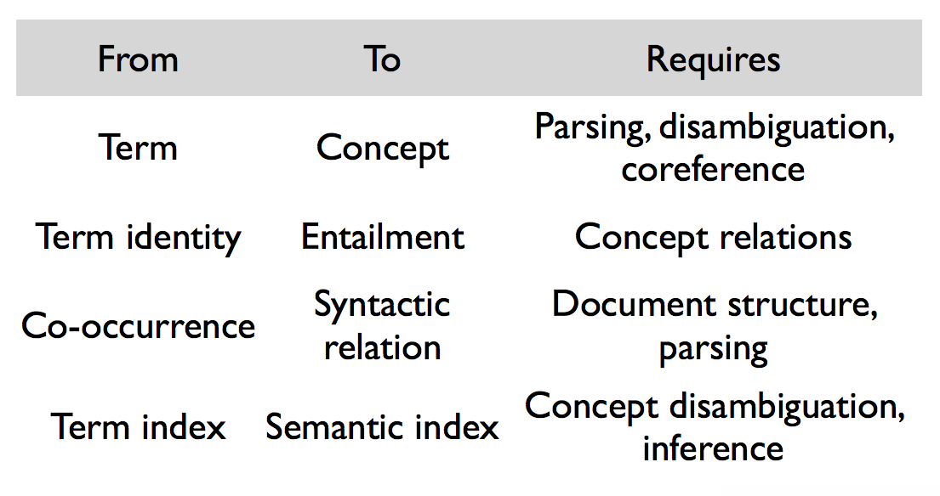
“Things, not strings”

Slide 58
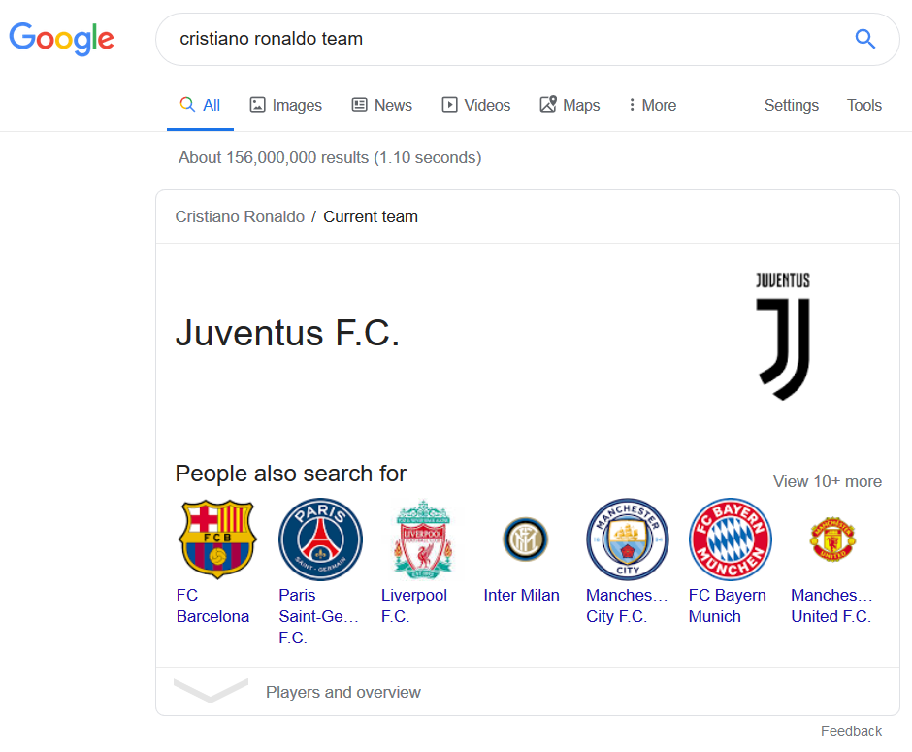
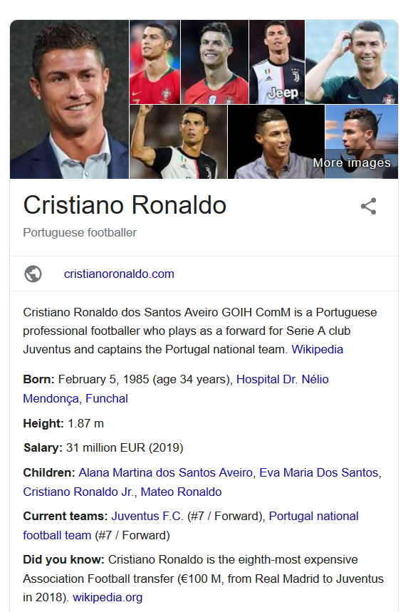
Structured Data
Direct Answer

Slide 59
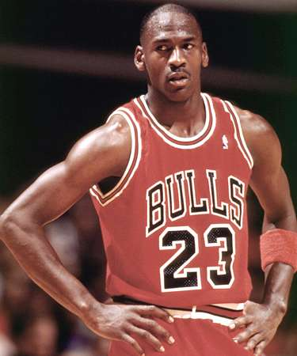
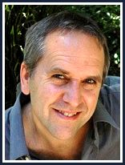
Entity disambiguation and linking
Key requirement is that entities get identified
Named entity recognition (e.g., Stanford NER!)
and disambiguated
Entity linking (or sometimes “Wikification”)
e.g., Michael Jordan the basketballer or the ML guy

Slide 60
Mentions, Meanings, Mappings [G. Weikum]
Eli (bible)
Sergio talked to
Ennio about
Eli‘s role in the
Ecstasy scene.
This sequence on
the graveyard
was a highlight in
Sergio‘s trilogy
of western films.
Eli Wallach
Benny Goodman
?
Ecstasy (drug)
Ecstasy of Gold
Benny Andersson
Star Wars Trilogy
KB
Lord of the Rings
Dollars Trilogy
Sergio means Sergio_Leone
Sergio means Serge_Gainsbourg
Ennio means Ennio_Antonelli
Ennio means Ennio_Morricone
Eli means Eli_(bible)
Eli means ExtremeLightInfrastructure
Eli means Eli_Wallach
Ecstasy means Ecstasy_(drug)
Ecstasy means Ecstasy_of_Gold
trilogy means Star_Wars_Trilogy
trilogy means Lord_of_the_Rings
trilogy means Dollars_Trilogy
… … …
Entities
(meanings)
Mentions
(surface names)
D5 Overview May 30, 2011
Notes:
Disambiguate by bringing together consistent grouping.

Slide 61
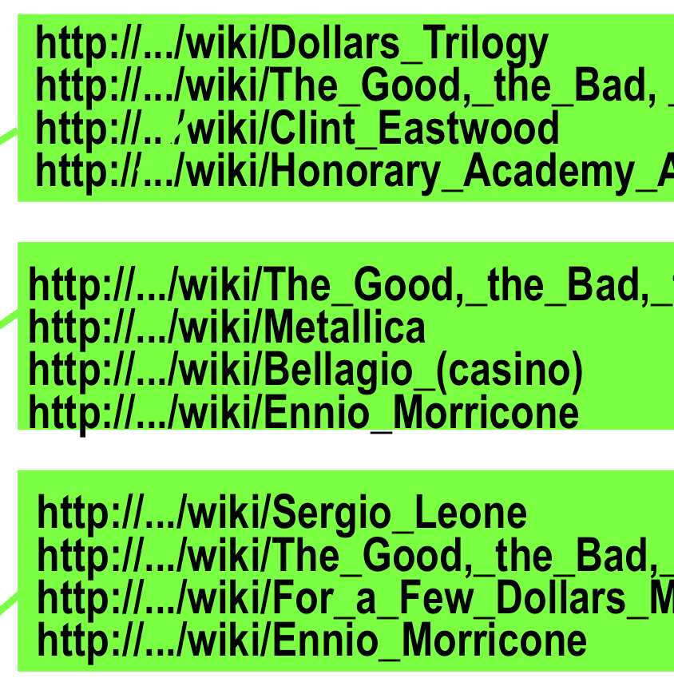
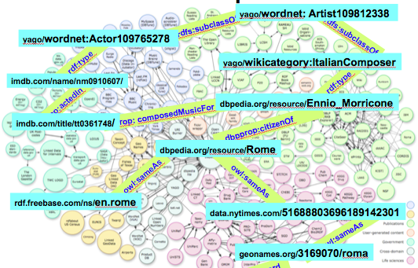
Canonical identifiers
and linked to a canonical reference
Freebase, dbPedia, Yago2, (WordNet)

Slide 62
Knowledge bases
NE Canonical identifier
NE Canonical identifier
Named entity: Cristiano Ronaldo
Named entity: Ronaldinho
NE Canonical identifier
Named entity: Juventus
Ronaldo got injured…
Cristiano Ronaldo scored another goal this…
CR7 is one of the best players.
Named entity disambiguation
CR7 joined Juventus.
Named entity mentions
Named entities relation

